Slide 1
What Impact Does Gasoline Taxes have on Prices and Sales of Gasoline?
DSC 630 Predictive Analytics
Caitie Schrotberger
Fall 2025
Notes:
Introduction

Slide 2

Gasoline Tax Impact on Price and Sales
Country relies heavily on gasoline
17% of the retail price of gasoline is taxes
How do taxes impact the price of gasoline?
Notes:
Gasoline is one of the United State’s most used fuels. Automobiles use gasoline to power their internal combustion engines. The retail price of gasoline averages $3.13 per gallon. That price is broken down between crude oil, refining, distribution, and taxes. Seventeen percent of that price is taxes which equates to about $0.53 per gallon. With that being said, how much impact do taxes have on the price and consumption of gasoline. One would assume as the price goes up consumers would switch their behavior to use less gasoline.

Slide 3
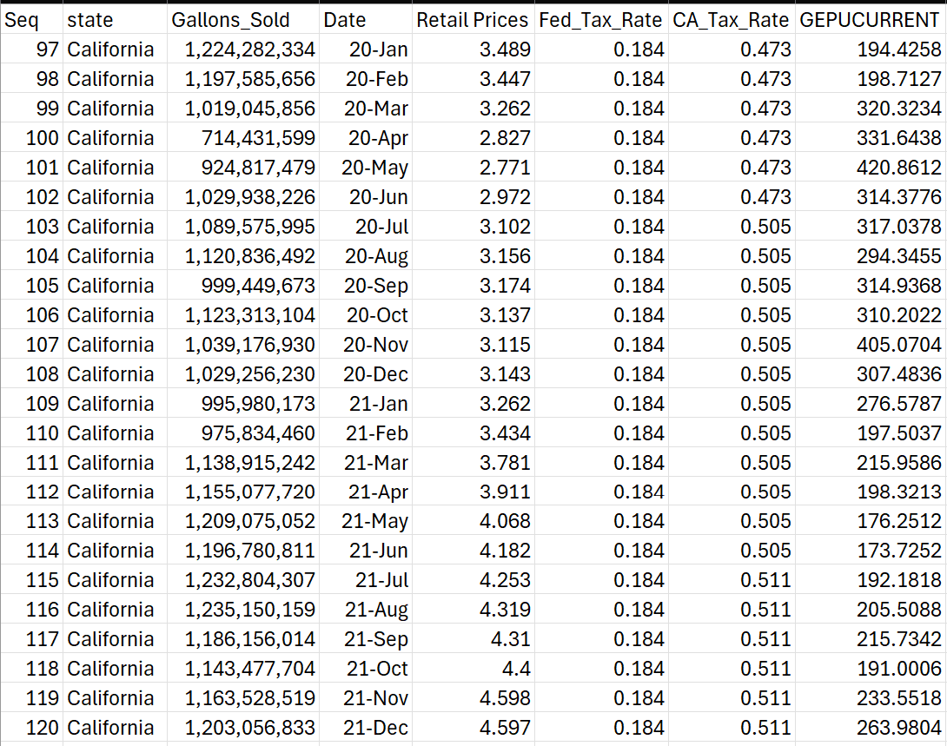
Data Selection
Using publicly available data sets:
Tax Rates by Motor Fuel and State
11 columns with annual data for 2,332 rows
Monthly Motor Fuel Sales Reported by States
8 columns with 15,252 rows
Weekly Retail Gasoline and Diesel Prices
4 data sets based on geolocation
Gross Domestic Product
Monthly data from 1997 to current
Data then complied to sync up data elements with time frames.
Notes:
Federal entities provide many data sets to the public for free. I sourced my data sets from the U.S Department of Transportation Bureau of Transportation Statistics, the U.S. Energy Information Administration, and the Federal Reserve Economic Data (FRED). All of these sites provide regular updates on many different statistics that can be used for a variety of proposes. In this case I’m using them for gasoline tax analysis.
Tax Rates by Motor Fuel and State provide the tax rate and each month it changes for all states.
Monthly Motor Fuel Sales Report by States provide the number of gallons each state sold on a monthly basis.
Weekly Retail Gasoline and Diesel Prices has the weekly price per gallon of several different fuel products which I restricted to gasoline only.
Gross Domestic Product is the weighted average of Economic Policy Uncertainty for 20 countries. This data set had multiple time dimensions and the monthly one was used.
Sample of California data combined is displayed in the table.

Slide 4
Risks Ethical Considerations Contingency Plan
Risks
Data not showing a correlation, state specific regulations, and economic conditions.
Ethical Considerations
For ethical implications, taxes can be a controversial topic, especially in the political world, analysis must be done so with no political bias.
Contingency Plan
Find different data sets:
crude oil production
socio-economic factors such as
Unemployment
consumer confidence
consumer spending
inflation
currency rates
population changes
political changes
Adjust my problem statement
Notes:
Risks – data is coming from a federal source, so confidence is high that the data is valid. Risk could be that there is not a correlation or that other economic conditions impact portions of the data.
Ethical Considerations – Taxes are controversial, especially in the political world so analyss must be done without political bias
Contingency Plan – Find different data sets with socio-economic factors or adjust my problem statement

Slide 5
Data Models and Evaluation Plan
Model Type
Linear Regression
Ridge Regression
Lasso Regression
Random Forest
Evaluation Metrics
Root Mean Square Error (RMSE)
R-squared (R²)
Notes:
Based on the data I have chosen the best model type for analysis will be regression. I will be using linear regression and possibly Ridge or Lasso regression. These types of regression models are good at looking at continuous rather than categorical based results. The goal is to find the best model that uses the best variables and reduces overfitting.

Slide 6
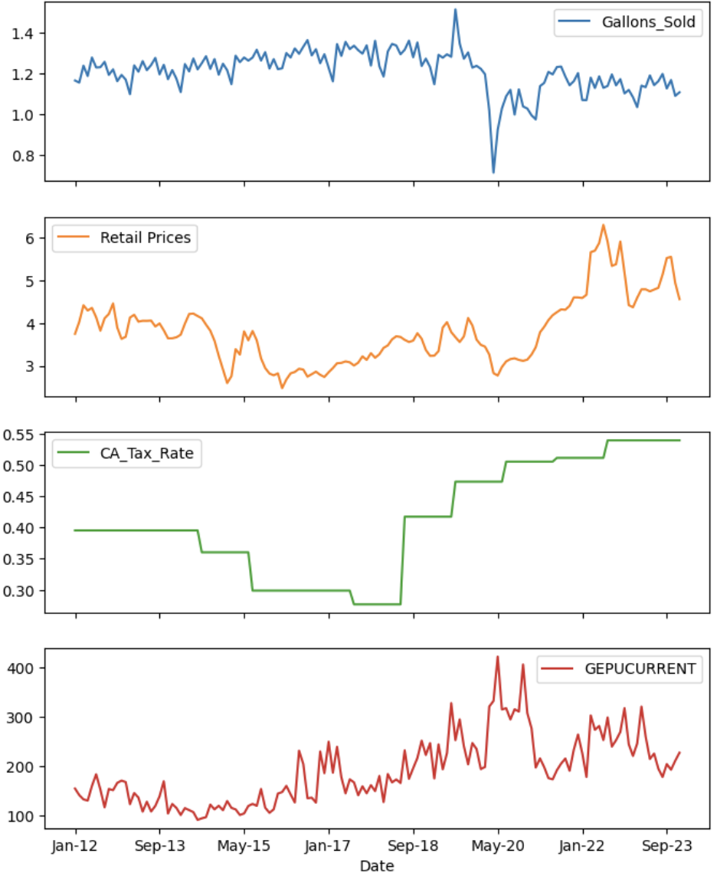
California Data
Notes:
These graphs show the California data over time for each of the four variables being evaluated. You can see the COVID outbreak in early 2020 had a significant impact in all metrics except tax rate – which had started to rise in 2018

Slide 7
Confusion Matrix
The California tax rate has:
a negative impact on the number of gallons sold
a positive impact on the retail price
a positive relationship to the GDP.
 | Gallons_Sold | Retail Prices | CA_Tax_Rate | GDP
Gallons_Sold | 1.000000 | -0.219050 | -0.593143 | -0.479213
Retail Prices | -0.219050 | 1.000000 | 0.666901 | 0.186847
CA_Tax_Rate | -0.593143 | 0.666901 | 1.000000 | 0.597674
GDP | -0.479213 | 0.186847 | 0.597674 | 1.000000
Notes:
The California tax rate has a negative impact on the number of gallons sold, a positive impact on the retail price, and a positive relationship to the GDP.
Correlation matrix had some impressive results. Retail prices had a 0.67 correlation with the tax rate, which makes sense. As the tax price goes up so should the retail price. GDP also influenced the tax rate positively (0.60) and the number of gallons sold negatively (-0.48). When GDP increases, the economy grows, and on the inverse the economy is struggling and may even be in a recession. It’s interesting then that a higher GDP would cause a decrease in the volume of gallons sold. It does make sense that the tax rate would increase as GDP does. The correlation between GDP and the retail price itself was 0.19, which is smaller than I would have predicted without looking at the data.

Slide 8
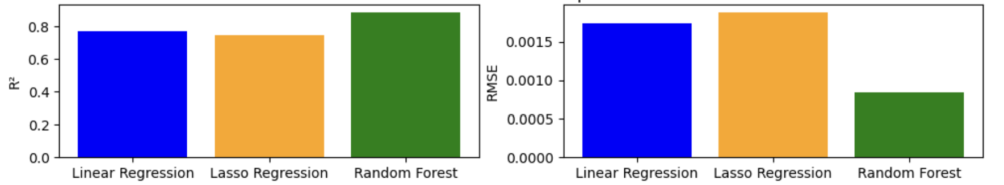
Model Performance
I started my analysis looking at the impact of price, gallons sold, and GDP influencing on predicting tax rate. These graphs show the difference in the model R^2 and RMSE results. When the R^2 is closer to 1 the model is a better fit to the date. The desired RMSE is closer to zero.

Slide 9
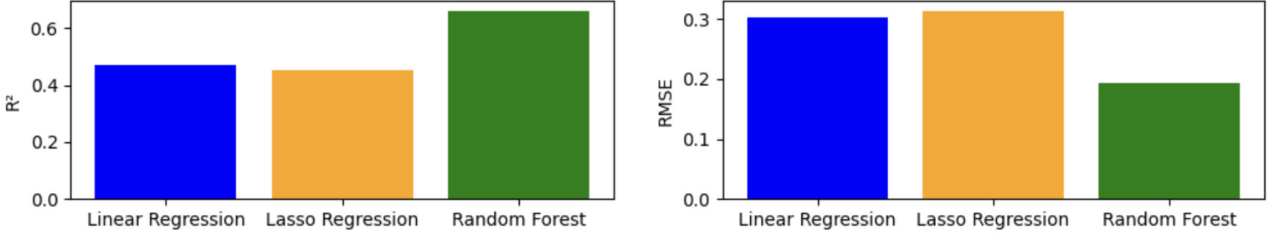
2nd Model Performance
After looking at the results of these, I decided to go back and rerun the same models but where prices were the target and only taxes is the only feature. This would better answer the question: “What impact does gasoline taxes have on prices and sales of gasoline”.

Slide 10
Model Interpretation
First regression model had comparable results in R² were about .75 and low RSME indicating high fit and little variance in the model. The Random Forest mode had an R² of .89 with an RSME 50% lower than the regression models. But this model had tax rate as the target variable.
The second model was run with the target variable of price and the tax amount as the only other model variable. This time the R² were much lower at about 50% of the first model with higher variability in the RSME.
Notes:
The different models generally work better with diverse types of data. Linear regression is great for a baseline model. Ridge and lasso models manage multicollinearity better. Whereas random forests is a flexible non-linear model.

Slide 11
Conclusion
There are relationships between taxes and the other features
Using the retail price, gallons sold, and GDP can predict the tax rate
The tax rate alone and its ability to predict the retail price does not have strong models.
My initial proposal was that as taxes go up so should the retail price leading to decreased sales. The models have shown that they could predict the retail price based on taxes but which much variance. This tells me that the other features are needed to accurately predict retail prices and volume of gasoline sold.
To be able to deploy a model for this topic, additional models would need to be run.
Notes:
Based on these model results I know there are relationships between taxes and the other features. Using the retail price, gallons sold, and GDP can predict the tax rate. When just looking at the tax rate alone and its ability to predict the retail price, the models are not as strong. This means that there are multiple variables that go into predicting the tax rate and price and using just one will not produce a strong model. My initial proposal was that as taxes go up so should the retail price leading to decreased sales. The models have shown that they could predict the retail price based on taxes but which much variance. This tells me that the other features are needed to accurately predict retail prices and volume of gasoline sold.
To be able to deploy a model for this topic, additional models would need to be run that include additional factors and look at different geolocations. I would start with one of the regions, then look to add some of the other data sets mentioned in the contingency plan section, hoping to find a stronger correlation in variables.

Slide 12

Caitie Schrotberger
DSC 630 Predictive Analytics
Fall 2025
Professor Andrew Hua

